Slide 1
BUSINESS TRIP REQUEST
Presented By:- BATCH 9 BTR

Slide 2

Introduction to BTR
Tools and Technologies
Overview of the project
Process Flow of project
System Design
AGENDA

Slide 3

TOOLS AND TECHNOLOGIES
The tools and technologies used are as follows:-
Frontend | HTML, CSS, Javascript, JSP
Backend | Oracle DB, JDBC
IDE | Eclipse IDE for Java and Web Developers

Slide 4
INTRODUCTION TO BTR
BTR stands for Business Trip Request.
A trip request is the procedure through which workers seek pre-approval of travel based on specified criteria in the field of business travel.
Business travel is a journey specifically taken for work purposes and doesn’t include daily commutes, leisure trips or holidays.

Slide 5
OVERVIEW OF THE PROJECT
Create New Request:- After the user is successfully requested the user request details will be submitted to L1,L2 and L3.
Request Approval:- The requestor places request for approval of the trip request which goes to the L1 ,L2 and L3.and after verification the request gets approve/reject.

Slide 6
PROCESS FLOW OF PROJECT
User will be informed for request approval
User submit the request for approval.
Approver approve the request as per the hierarchy.
Approver approve the request as per the hierarchy.
Requestor
Approver L1
Approver L2
Approver L3
Requestor will request for the trip by filling the required details
Approver reject the request
Approver reject the request
Approver reject the request
User will be Informed

Slide 7
SYSTEM DESIGN

Slide 8
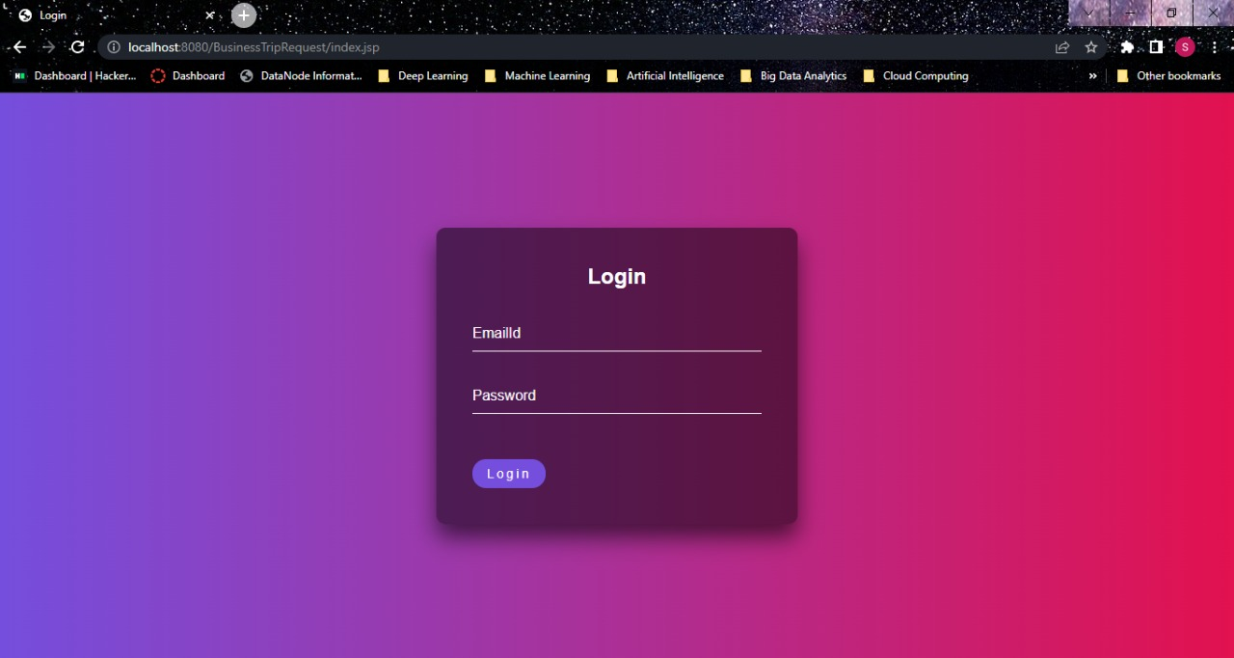
LOGIN PAGE

Slide 9
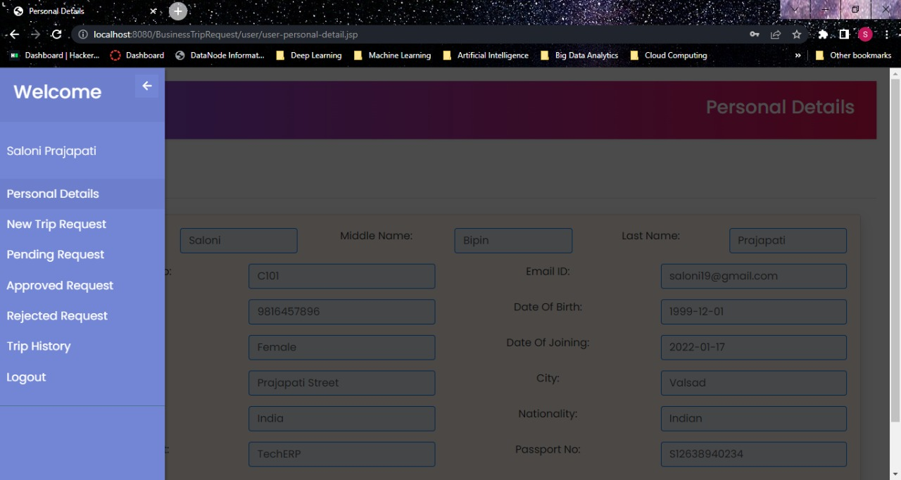
USER DASHBOARD

Slide 10
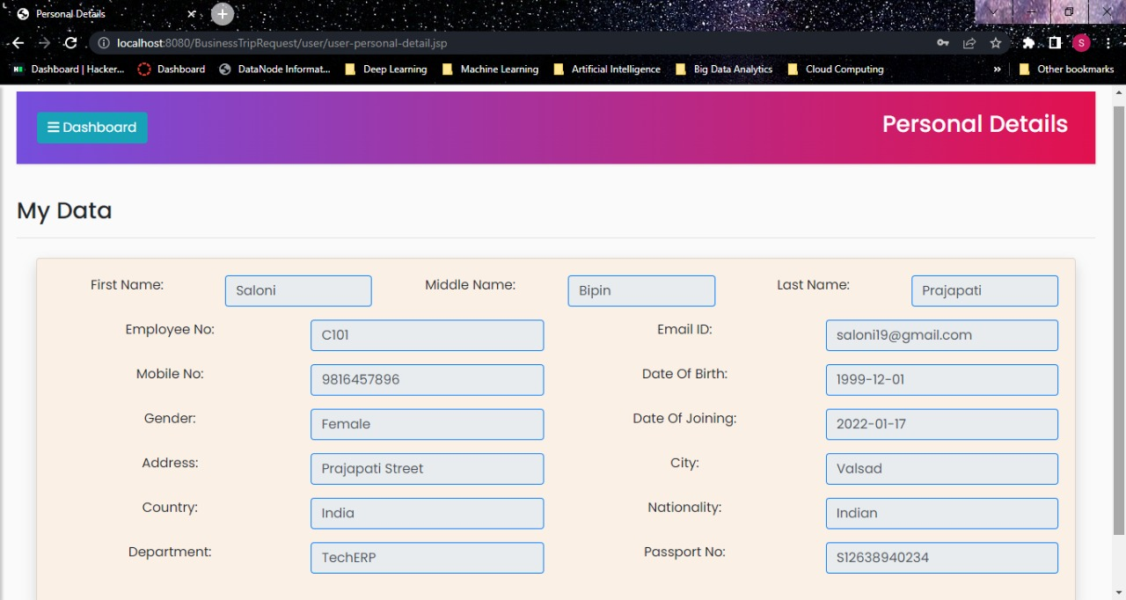
USER PERSONAL DETAILS

Slide 11
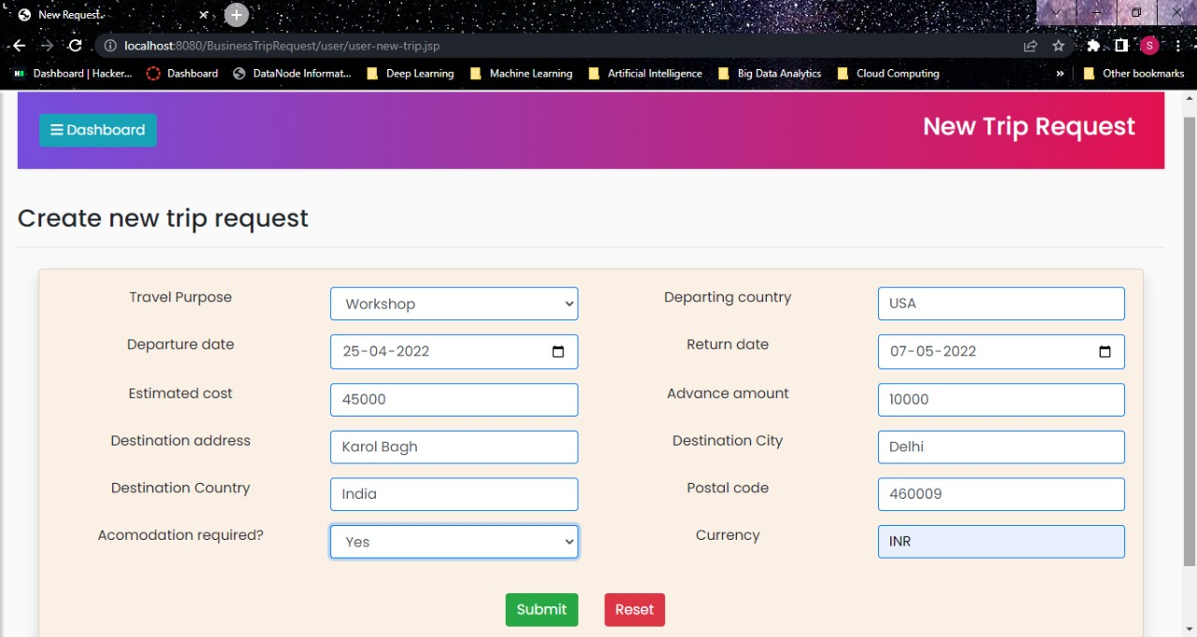
USER NEW TRIP REQUEST

Slide 12
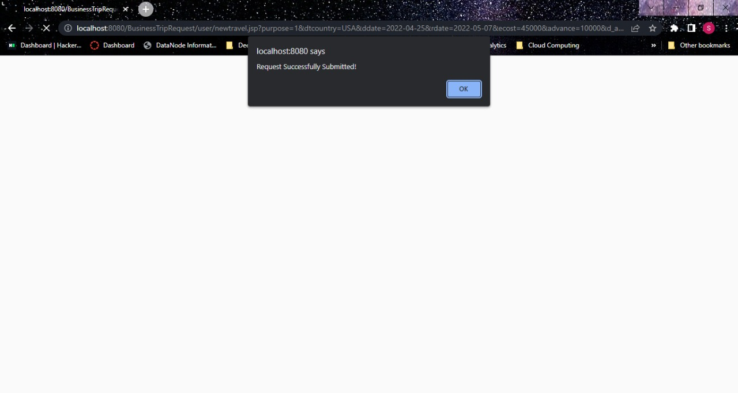
NEW TRIP REQUEST SUCCESSFULLY SUBMITTED

Slide 13
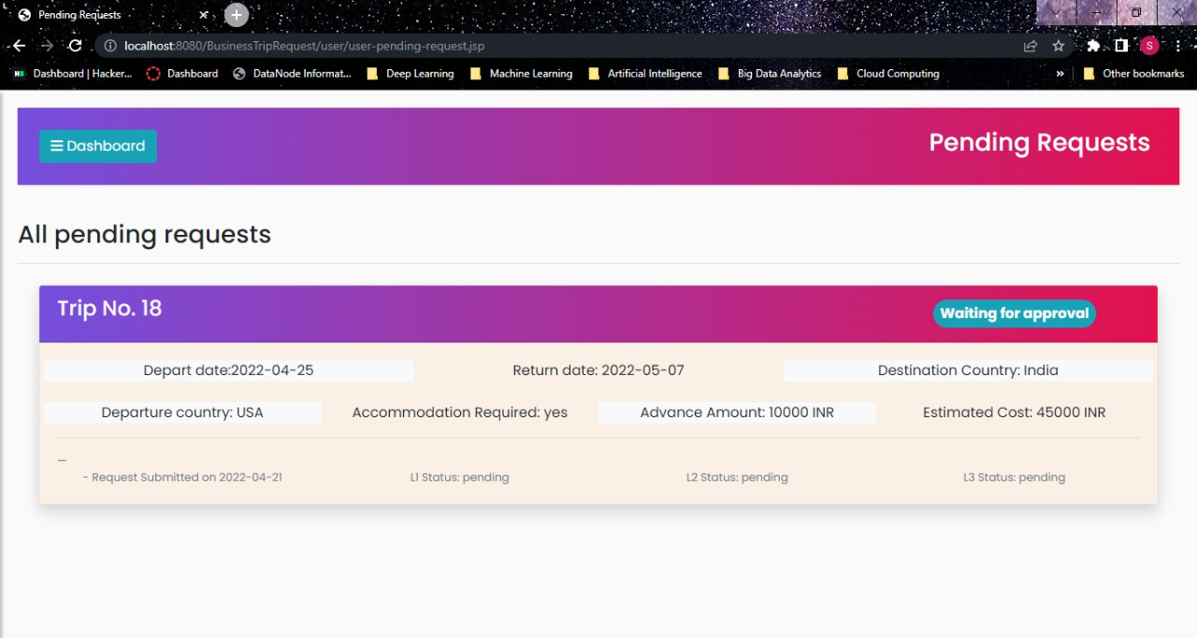
USER ALL PENDING REQUEST

Slide 14
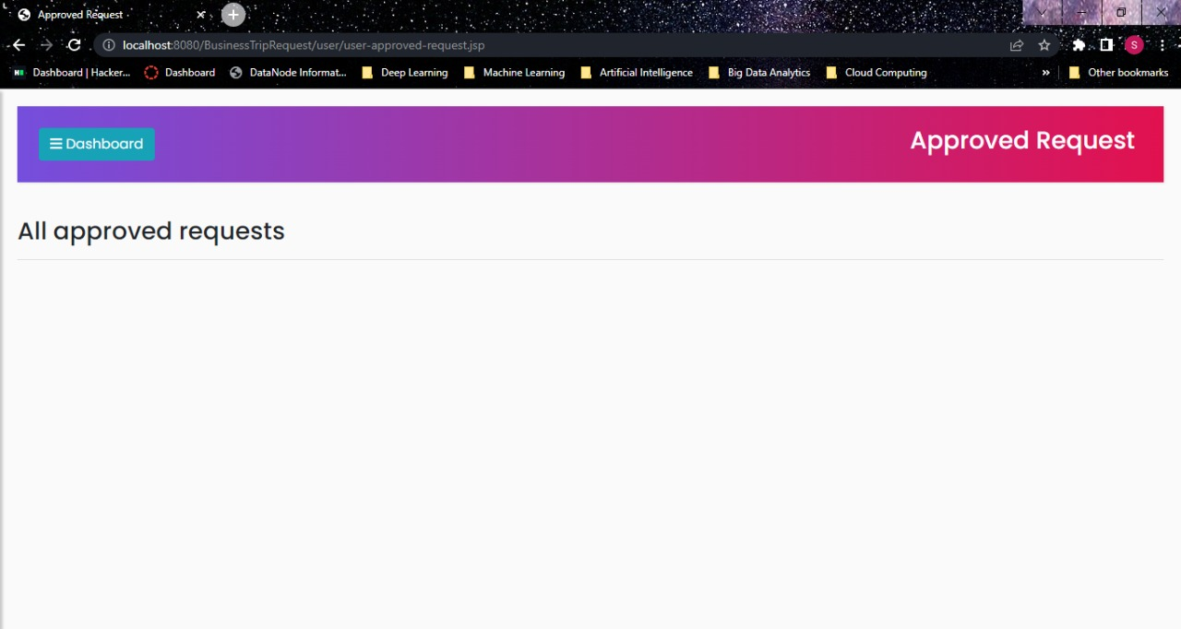
USER ALL APPROVED REQUEST

Slide 15

USER ALL REJECTED REQUEST

Slide 16
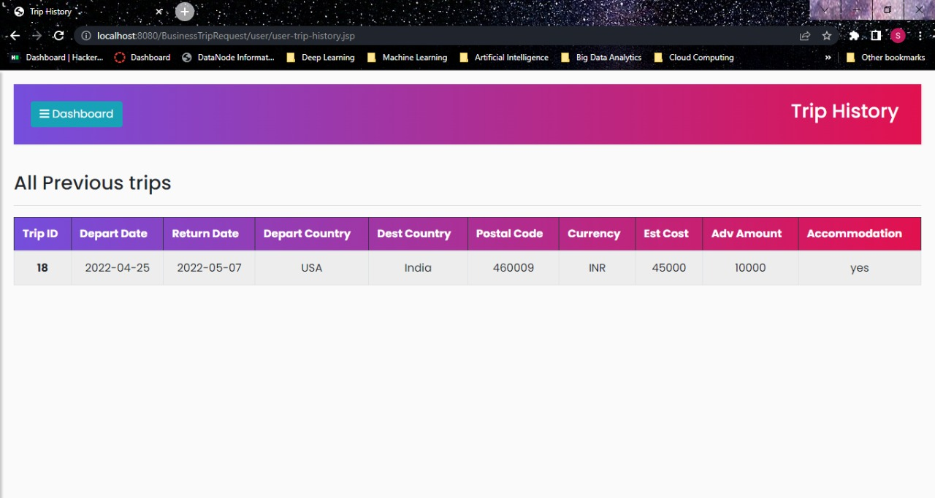
USER TRIP HISTORY

Slide 17
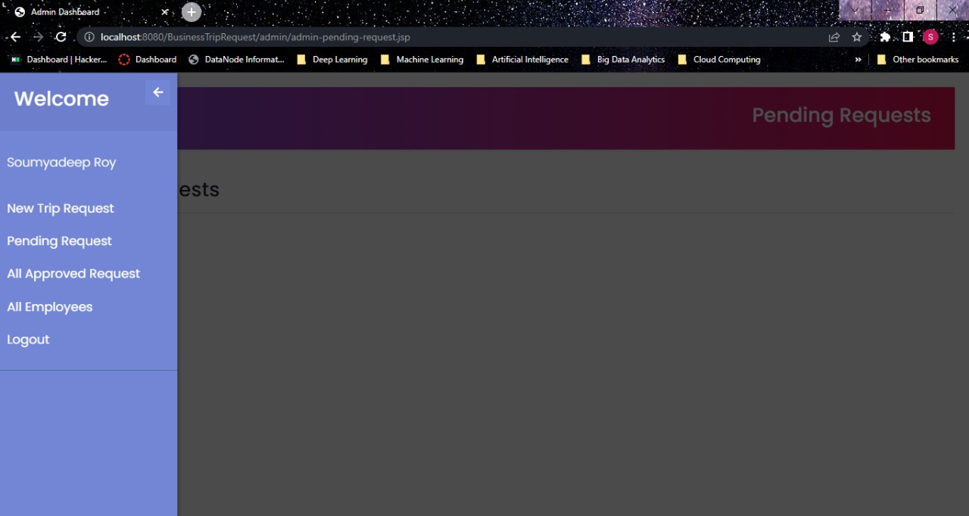
ADMIN L1 DASHBOARD

Slide 18
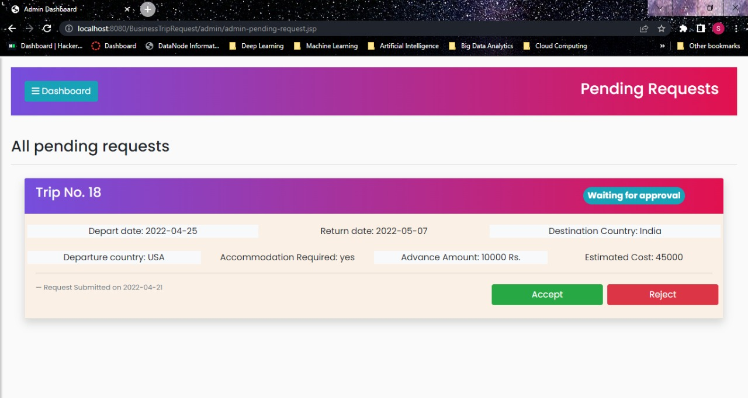
ADMIN L1 ALL PENDING REQUEST

Slide 19
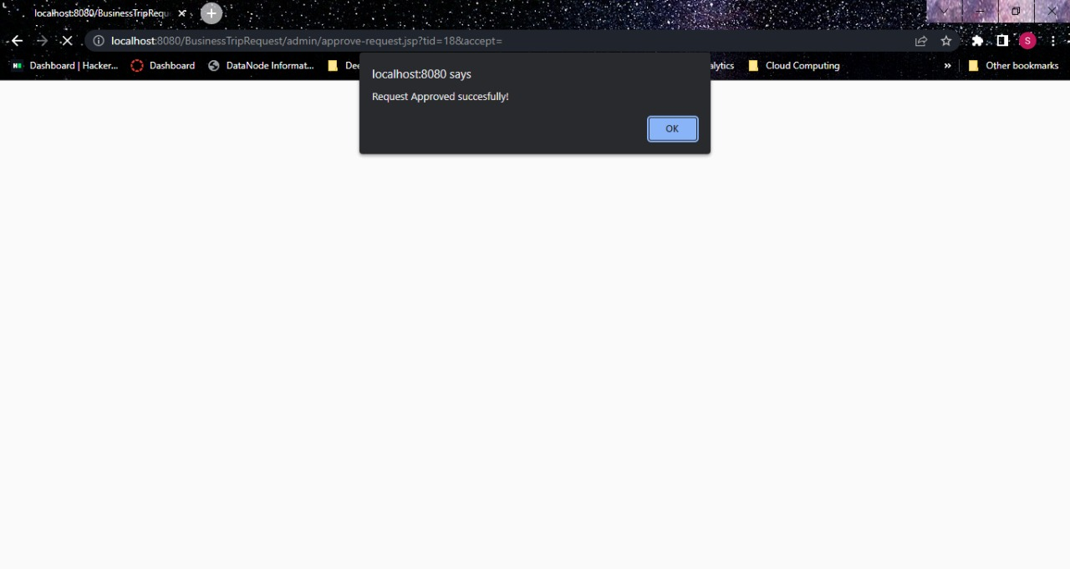
ADMIN L1 REQUEST SUCCESSFULLY SUBMITTED

Slide 20
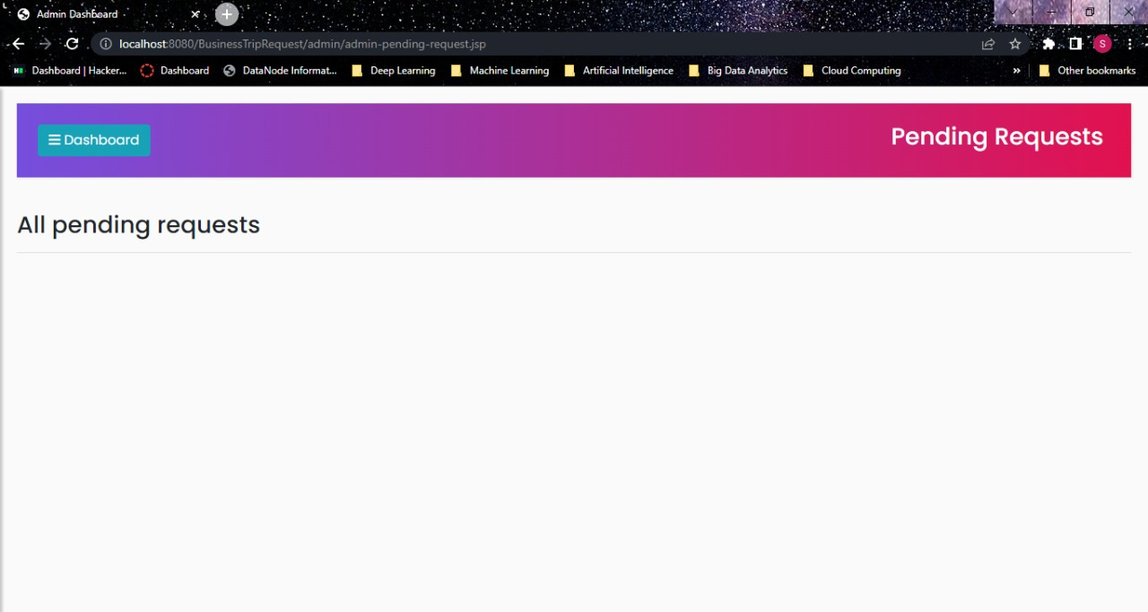
ADMIN L1 AFTER ACCEPTING THE REQUEST

Slide 21
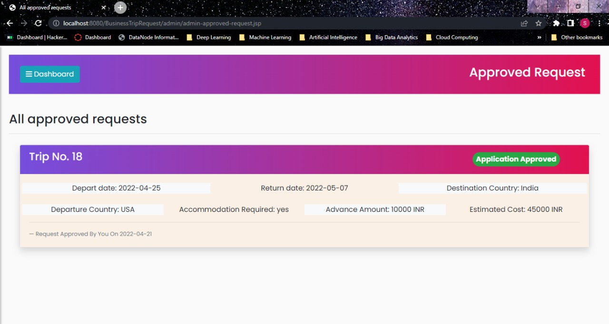
ADMIN L1 ALL APPROVED REQUEST

Slide 22
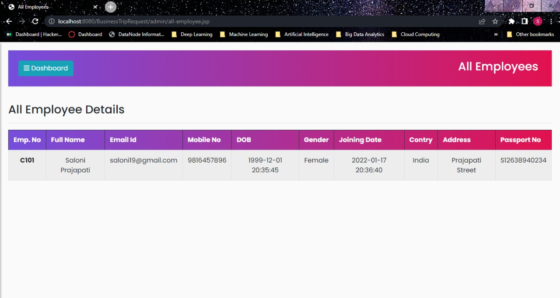
ALL EMPLOYEE DETAILS

Slide 23
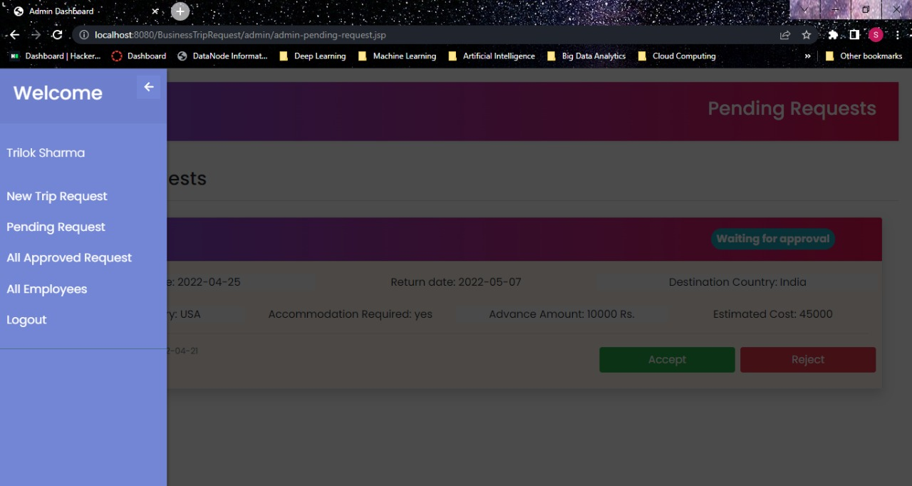
ADMIN L2 DASHBOARD

Slide 24
ADMIN L2 ALL PENDING REQUEST

Slide 25

ADMIN L2 REQUEST SUBMITTED SUCCESSFULLY

Slide 26
ADMIN L2 AFTER ACCEPTING THE REQUEST

Slide 27
ADMIN L2 ALL APPROVED REQUEST

Slide 28
ADMIN L2 ALL EMPLOYEE DETAILS

Slide 29

ADMIN L3 DASHBOARD

Slide 30
ADMIN L3 ALL PENDING REQUEST

Slide 31

ADMIN L3 REQUEST SUBMITTED SUCCESSFULLY

Slide 32
ADMIN L3 AFTER ACCEPTING THE REQUEST

Slide 33
ADMIN L3 ALL APPROVED REQUEST

Slide 34
ADMIN L3 ALL EMPLOYEE

Slide 35
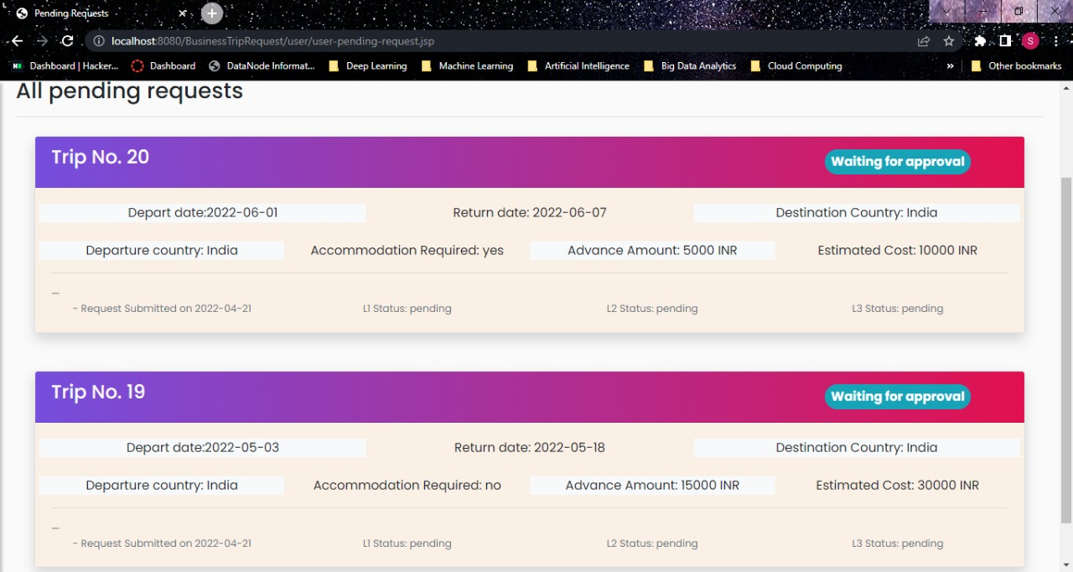
TRIP REJECTION PROCESS

Slide 36
ALL REJECTED REQUEST

Slide 37
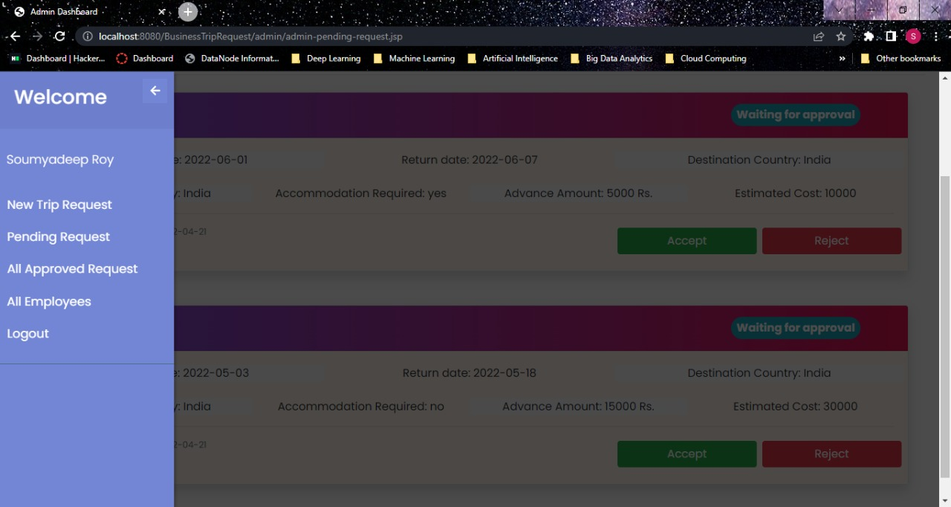
ADMIN L2 ACCEPT REJECT PAGE

Slide 38
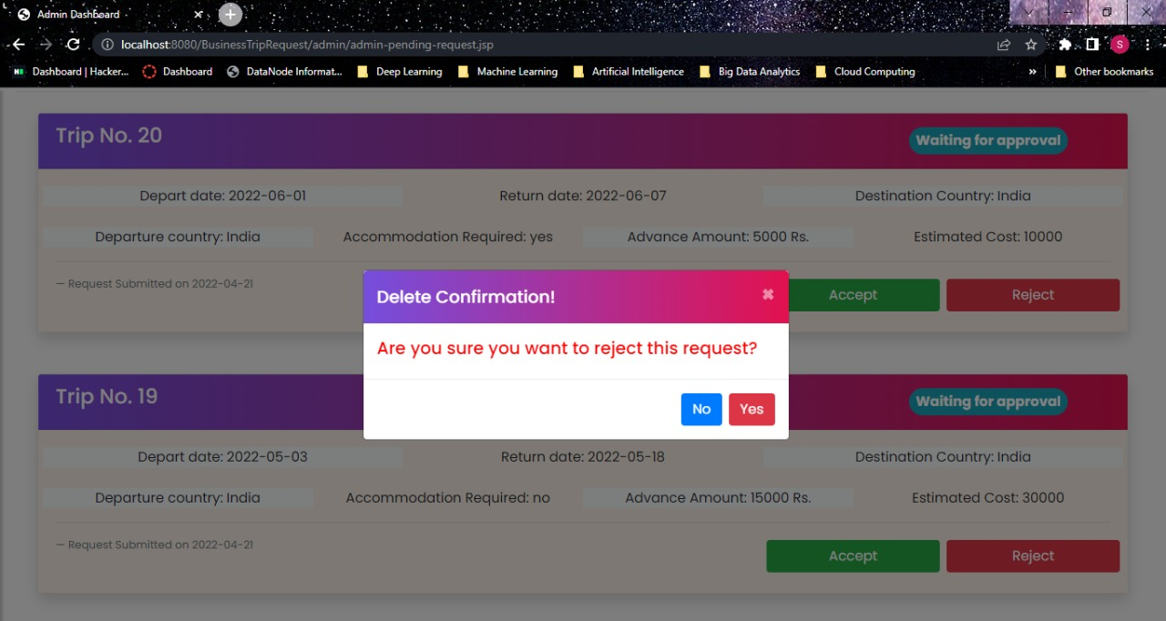
ADMIN REQUEST REJECT CONFIRMATION

Slide 39

TRIP REQUEST REJECTED

Slide 40
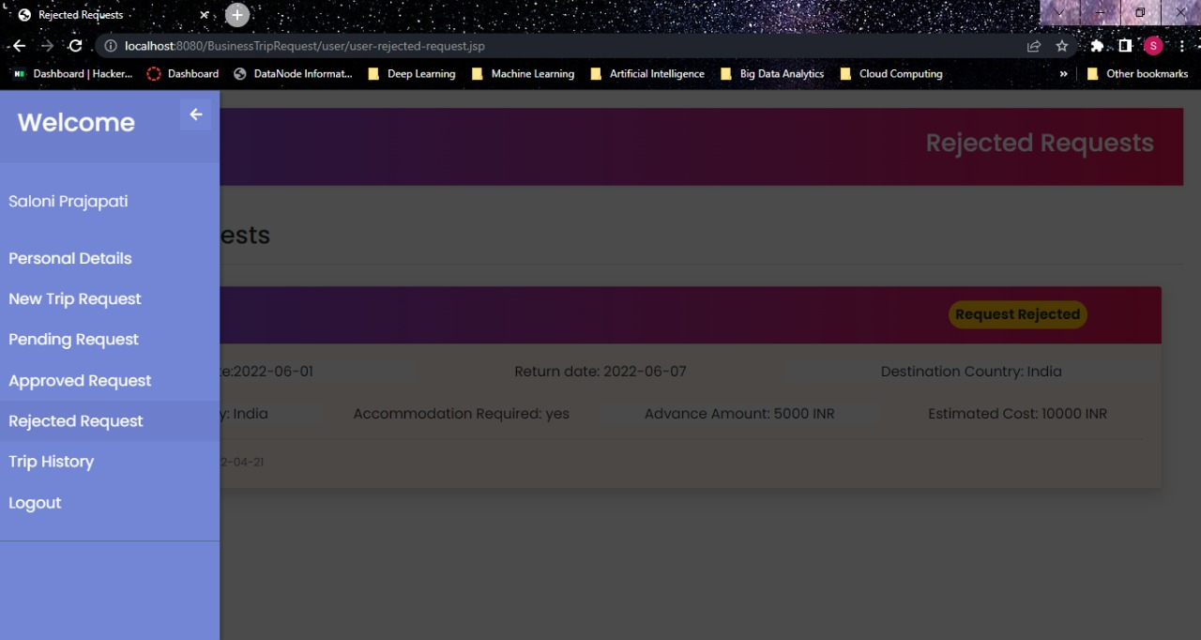
USER ALL REJECTED REQUEST

Slide 41
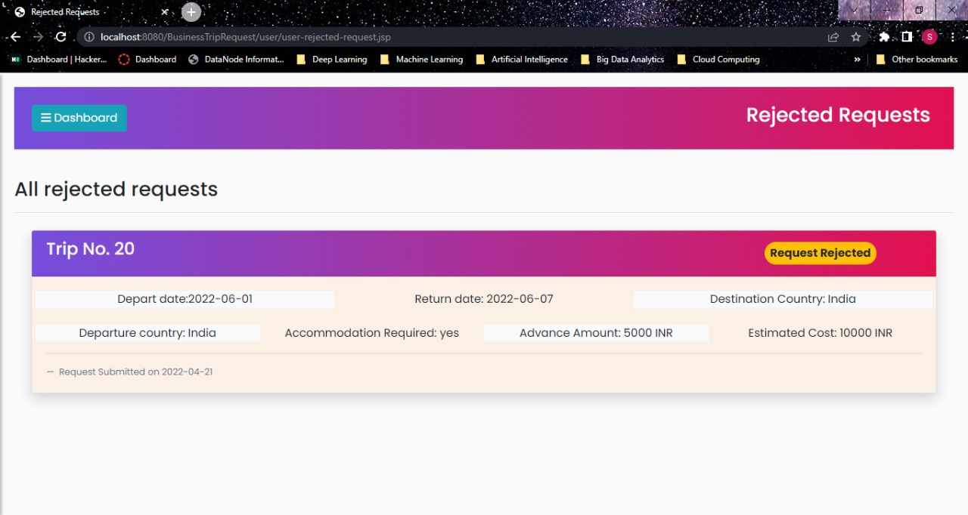
ALL REJECTED REQUEST

Slide 42
THANK YOU

